Slide 1
Ocean Temperature Dependence on Depth and Time of Day
Evan Chapman, Jacey Coniff,
Jacob Garcia, Elizabeth Poss

Slide 2
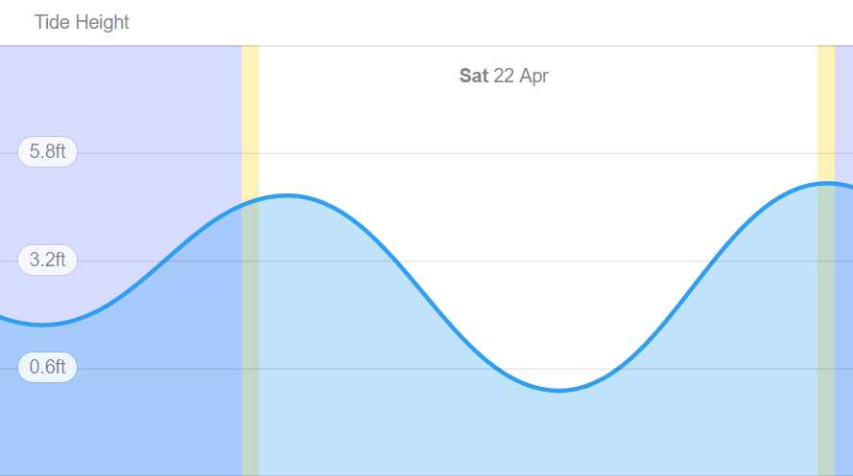
Project Goals
Original Goal: Investigate how tide and depth affect temperature and turbidity at a waypoint.
Revised Goal: Investigate how temperature changes with depth and time of day.
Low Tide: 1:19 PM
Notes:
Mention Dana Point

Slide 3
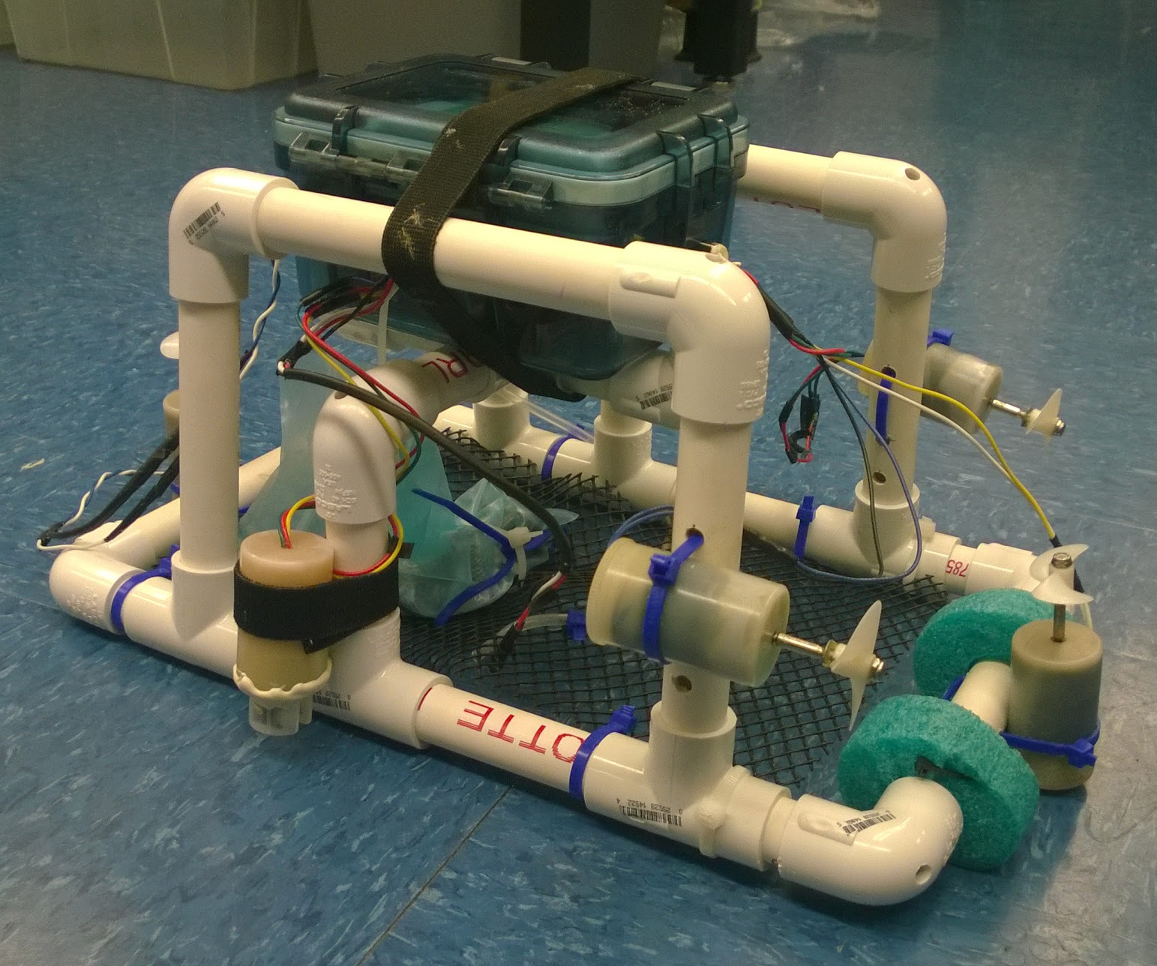
Measurement Sensors and Robot Construction
MPX5700 Pressure Sensor
MCP9701A Low-Power Linear Temperature Sensor
TSW-10 Turbidity Sensor
Ballasting
Turbidity Sensor
Temperature Sensor
Pressure
Sensor
Notes:
Pressure Sensor: had previous experience with it and were successful amplifying signal for certain ranges
Temperature Sensor: Solid State Linear because could achieve larger amplification than with a thermistor, and didn’t need a fast time constant since hovering at each depth
Turbidity Sensor: Cheap enough to be within budget, relatively simple
Bot constructed with box on top so it could receive GPS signal, ballasting added to the bottom for stability, 4 motors, with vertical motors approximately equi-distance from center of boyuancy in order to dive correctly
Motors and turbidity sensor put in film canister and waterproofed using wax. Wires going into box epoxied, and four penetrators to ensure seal
PVC frame, teensy equipped with gps, data logger, magnetometer, placement of the motors far from box to not mess with magnetometer

Slide 4
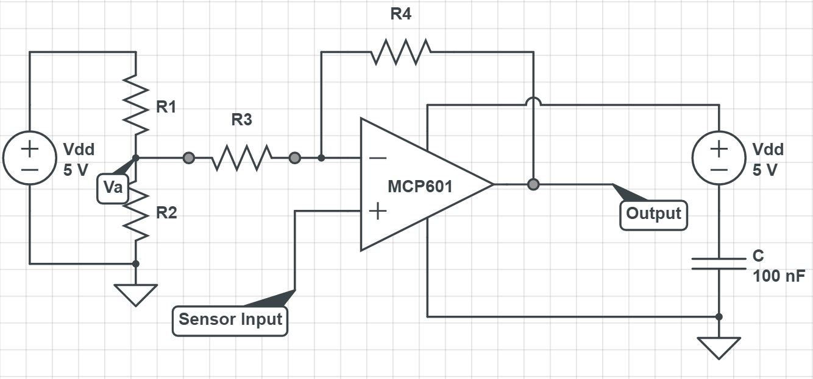
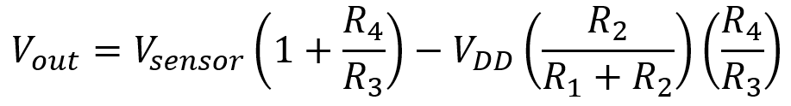
Op-Amp Sensor Amplification
Linear Sensor Responses
Imposed Condition: R2 << R3
Notes:
Linear sensor responses, the op amp circuit for all three, governing equation and condition
Measured original response, chose gain using R4 and R3, then adjusted offset using R2 and R1 so that the Teensy, which has a 0 to 3.3 V analog output range would measure the results

Slide 5
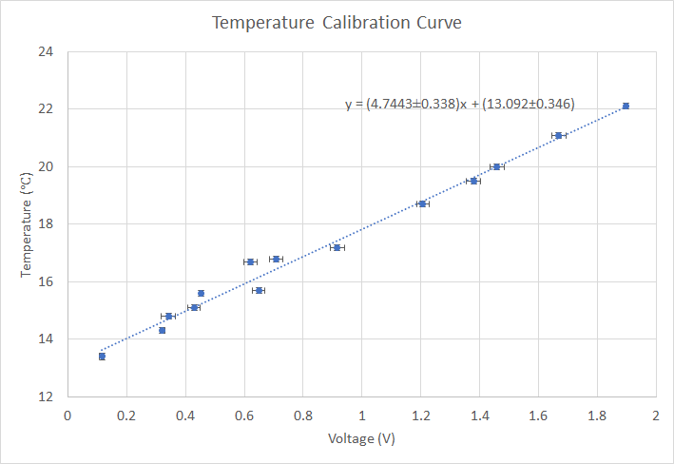
Circuit Design: Temperature
Desired Range | Designed Voltage | Actual Voltage
12.4 ± 0.1°C | 0.588 ± 0.019 V | 0.000 ± 0.004 V (Railed)
22.0 ± 0.1°C | 2.82 ± 0.02 V | 1.847 ± 0.148 V
Notes:
Across times of year?

Slide 6
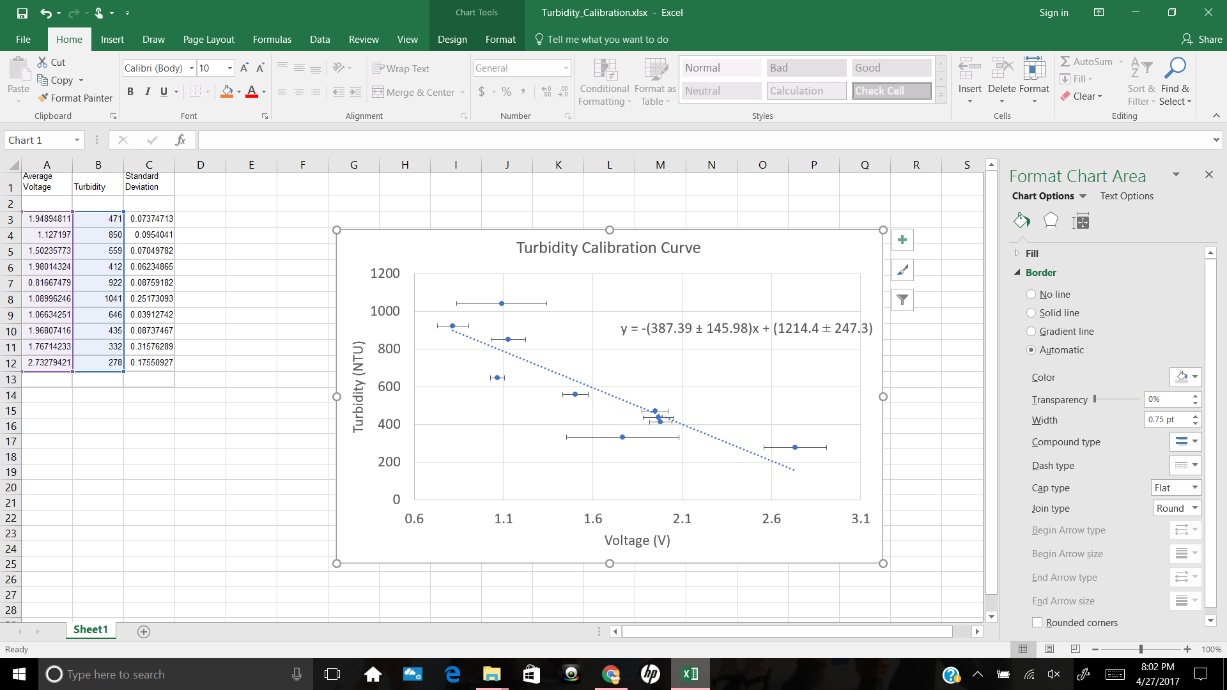
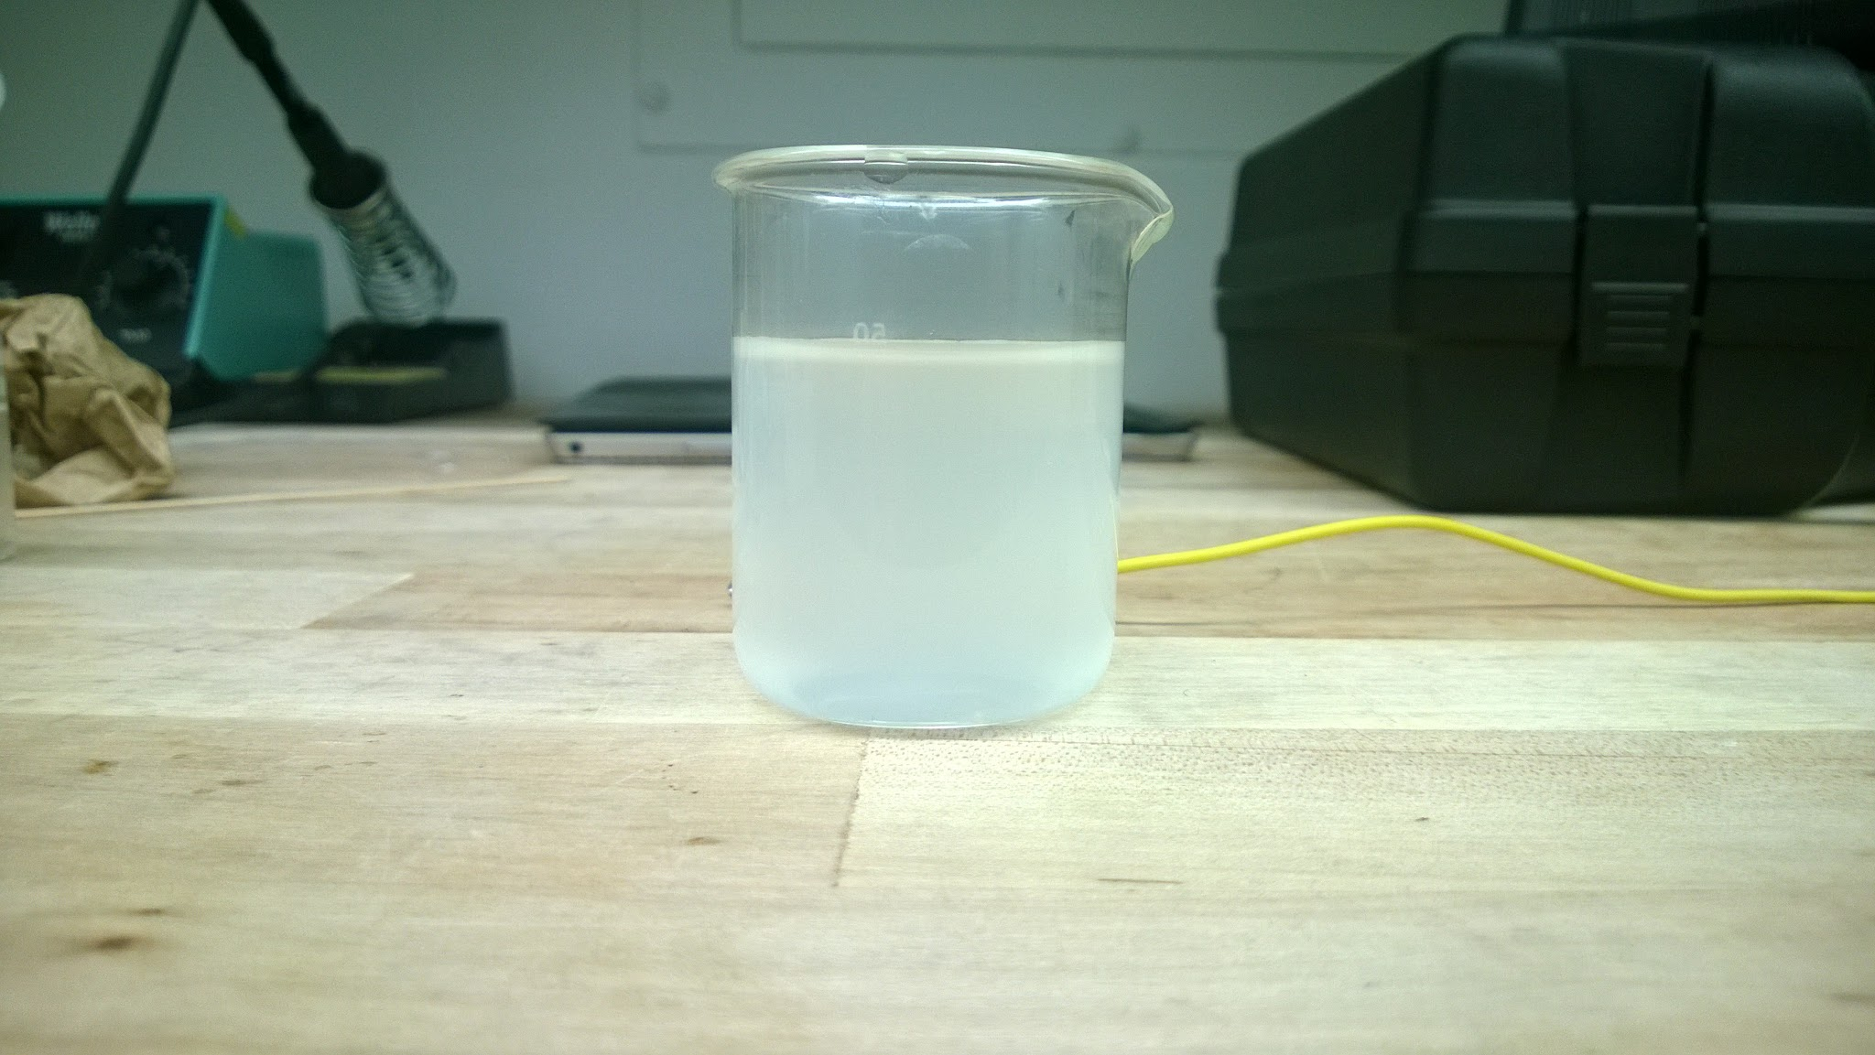
Circuit Design: Turbidity
Desired Range | Designed Voltage | Actual Voltage
0 ± 1 NTU | 3.342 ± 0.054 V | 3.300 ± 0.004 V (Railed)
430 ± 1 NTU | 0.172 ± 0.052 V | 1.94 ± 0.79 V
Figure 1: Sample at 194 NTU. This is more turbid than seawater yet still rails our circuit.

Slide 7
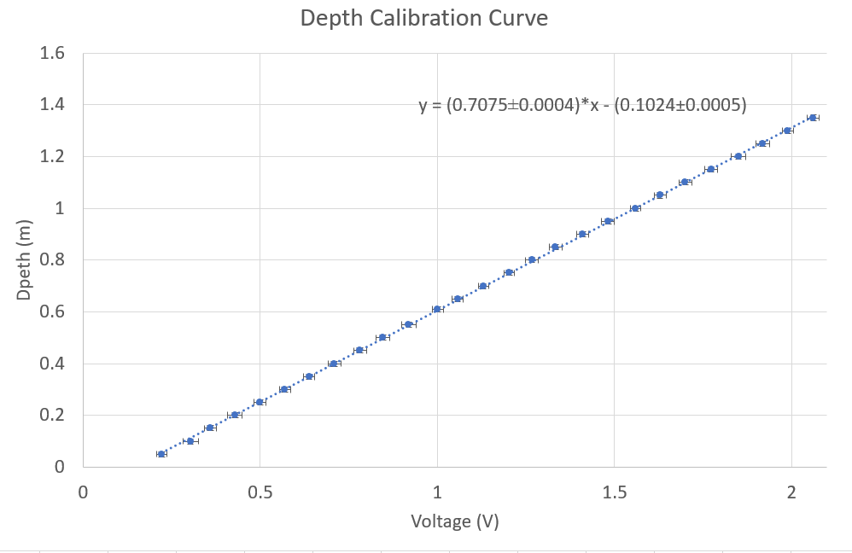
Circuit Design: Pressure
Desired Range | Designed Voltage | Actual Voltage
0.0 ± 0.01 m | 0.264 ± 0.024 V | 0.1448 ± 0.0019 V
2.0 ± 0.01 m | 3.34 ± 0.025 V | 2.9714 ± 0.0022 V

Slide 8
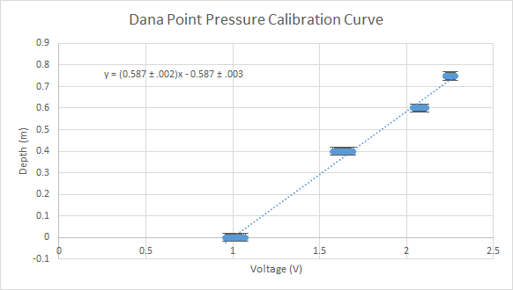
Pressure Re-calibration
Change in:
Elevation
Water density
Higher uncertainty
Careful measurement was impractical
Notes:
Other concern was that pressure was off, so we couldn’t use the same calibration curve. We quickly made a new one.
Calculated that the change altitude accounts for 4.6kPa of the observed 5.2kPa. Weather could have accounted for the rest within error, because we could not get exact barometric data for our specific locations retroactively. Therefore, we used the new calibration curve
Pressure Equation: P = (rho)gh
Elevation of Harvey Mudd College is 392m while elevation at Dana Point is 0m. Using the pressure equation we can calculate that the pressure difference due to altitude is 4.71 kPa. On deployment day at Dana Point we determined that our pressure sensor was reading a depth of .54m while in air which corresponds to 5.29 kPa. Therefore, we cannot account for .58 kPa of pressure difference. We conclude that this discrepancy could arise from atmospheric differences in pressure at Harvey Mudd College and Dana Point on specific days which we cannot determine retroactively.

Slide 9
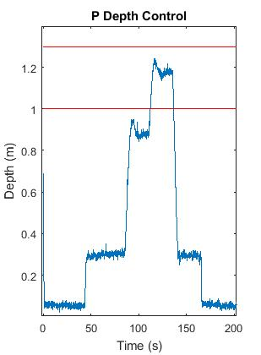
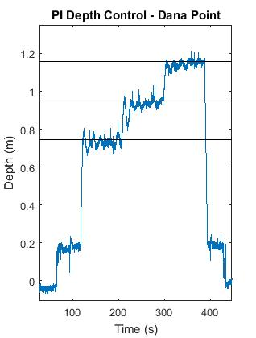
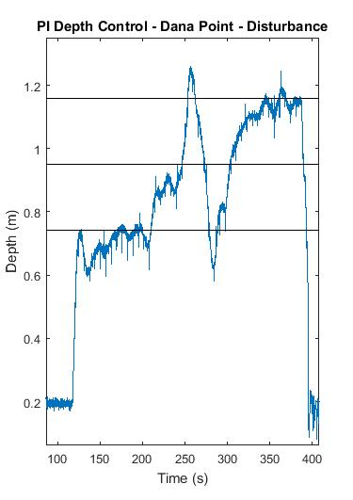
Software Modifications (Depth PI Control)
Even with careful ballasting, error was ≈ .1m for P control
PI control has longer settling time, so data acquisition periods were longer at Dana Point
Notes:
We didn’t know that our pressure calibration would be offset so much by change in elevation (and water density). So at the time, PI control paired with a long hover time seemed best
By the way, PI wasn’t the only modification… we were provided starter code that controlled the motors, etc

Slide 10
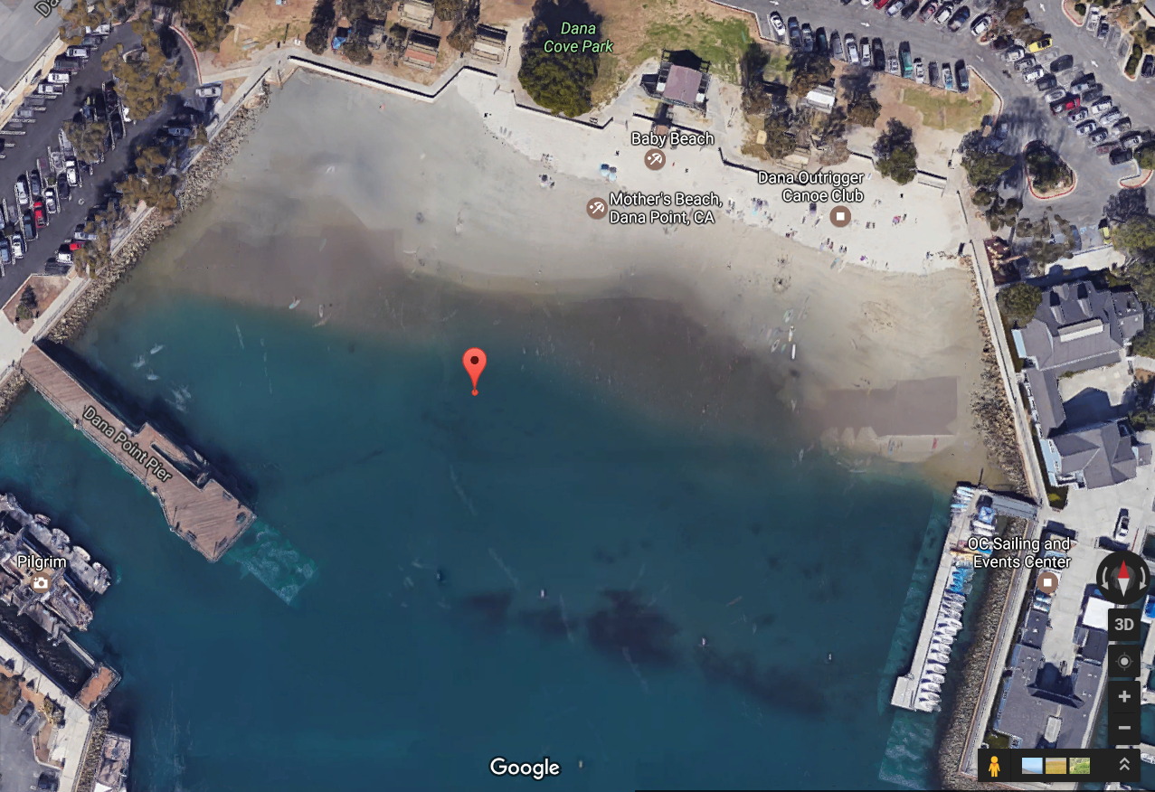
Data Collection: Procedure
Manually deployed and recovered robot near buoy
Deployer remained nearby to divert beach-goers
Deployment location within 5 ft radius of 33.462390, -117.705245
Notes:
Since there were problems finding accurate GPS locations with Google maps due to the ever-shifting nature of the beach, we decided to manually place the robot in a known location off a stationary buoy. We placed the bot within the error range of the GPS. We had a delay on the code as to account for the time it would take to place the bot in the water. Following the code the robot would then dive to prescribed depth, hover for 90 seconds, and move to the next depth.
Our turbidity data was unfortunately railed for the whole time
Start with our original plan for procedure then move into what went wrong and what we did to fix it. Need to touch on the new depth aspect.
5ft

Slide 11
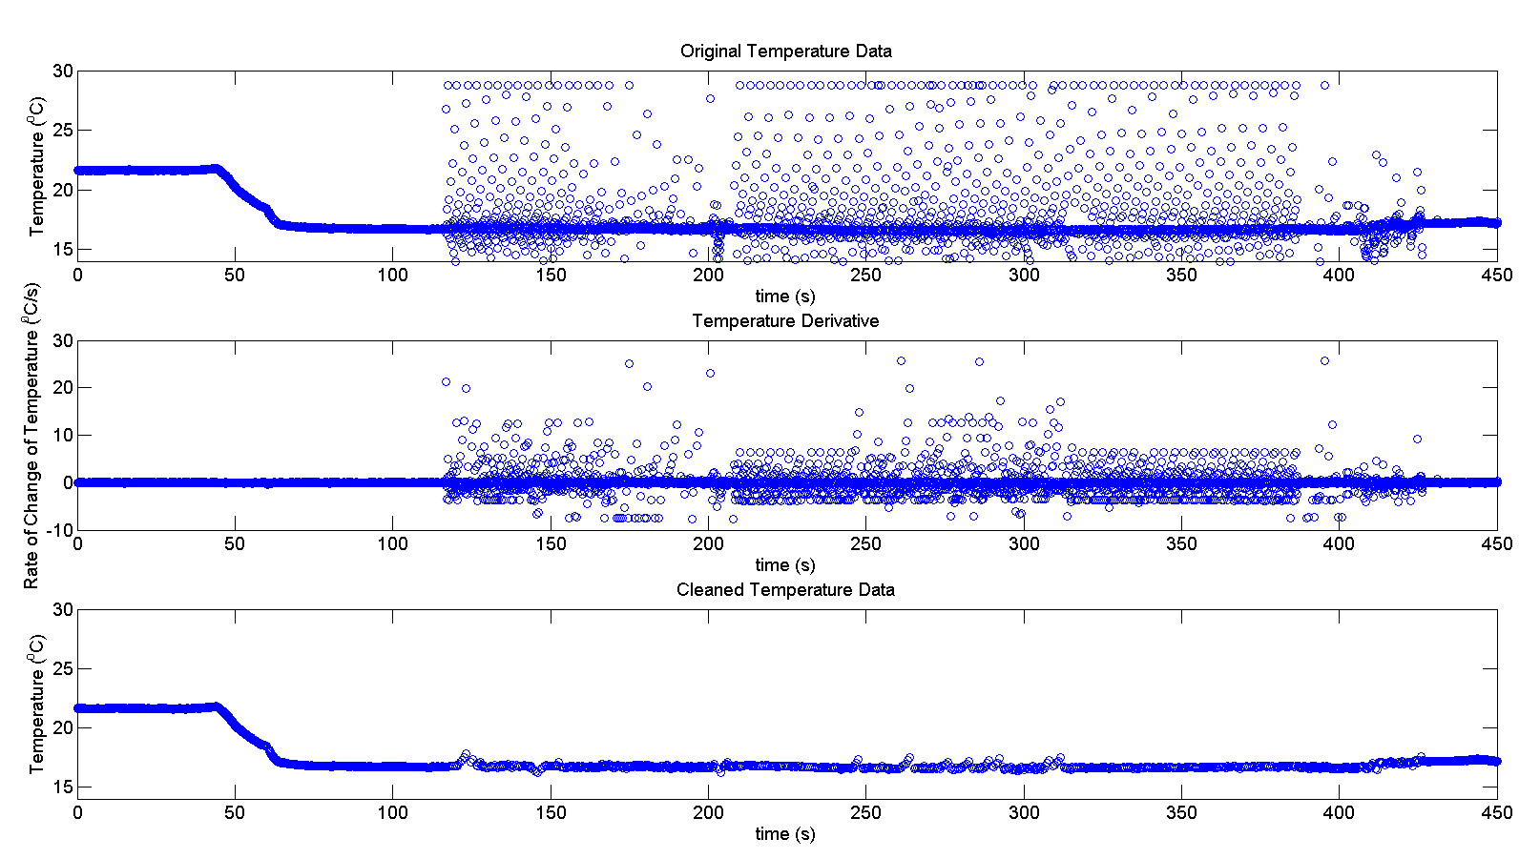
Data Analysis
Notes:
When vertical motors are turned on, there is a lot of noise. We couldn’t find the source (some sort of motherboard or protoboard issue because motors don’t even need to be connected)
Know that the solid state sensor has a time constant of 4 +/- 0.15s, so if the derivative is larger than that we can eliminate that data point as not valid
We looked at the derivative present during lab when we were moving the sensor between hot/cold baths. We knew that there would not be greater changing rate in the ocean as the temperature is more or less constant. Therefore we determined that we could delete any points with derivatives greater than the 1.5 degree Celcius per second as it is highly unlikely that this actually occured.
.15 degree Celcius per second is the max (absolute value

Slide 12
Statistical Analysis
Analysis of variance tests used to compare mean temperatures
ANOVA
Kruskal-Wallace
Temperature compared over course of deployment
Temperature at a certain depth compared across deployments

Slide 13
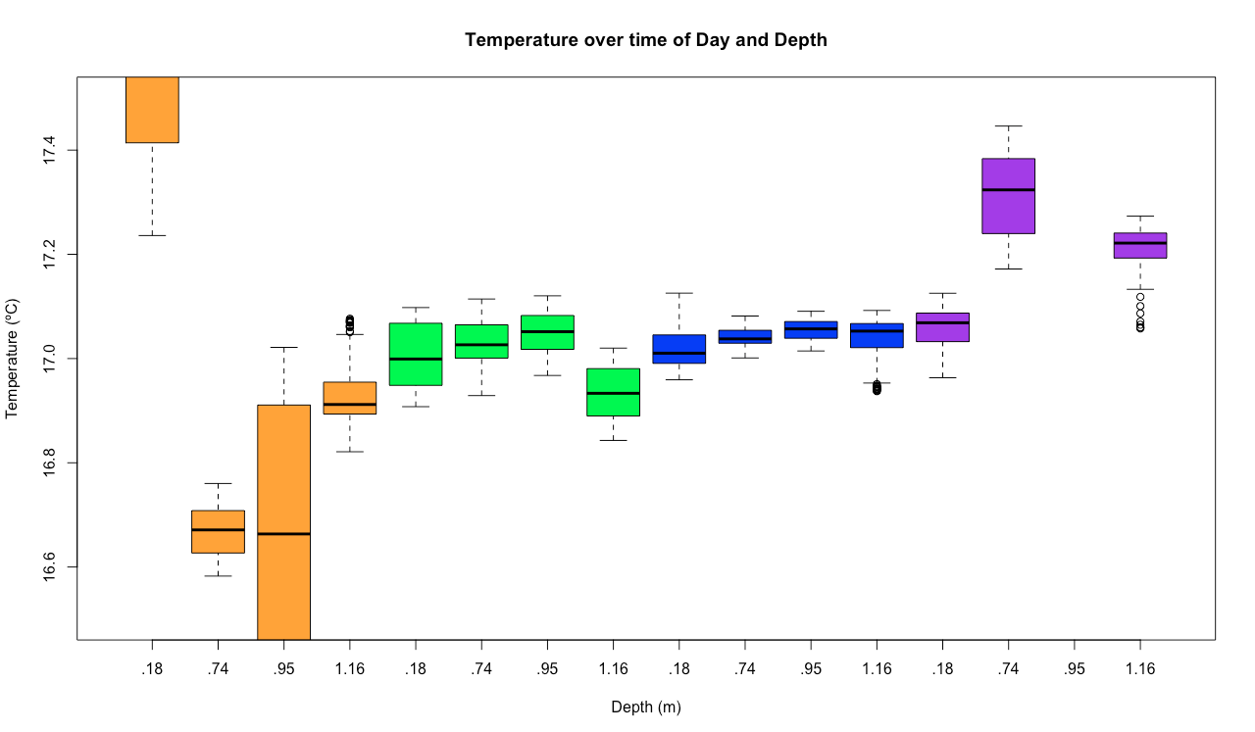
1:00pm
1:45pm
2:10pm
2:45pm
Notes:
Boxplots of temperature over deployment

Slide 14
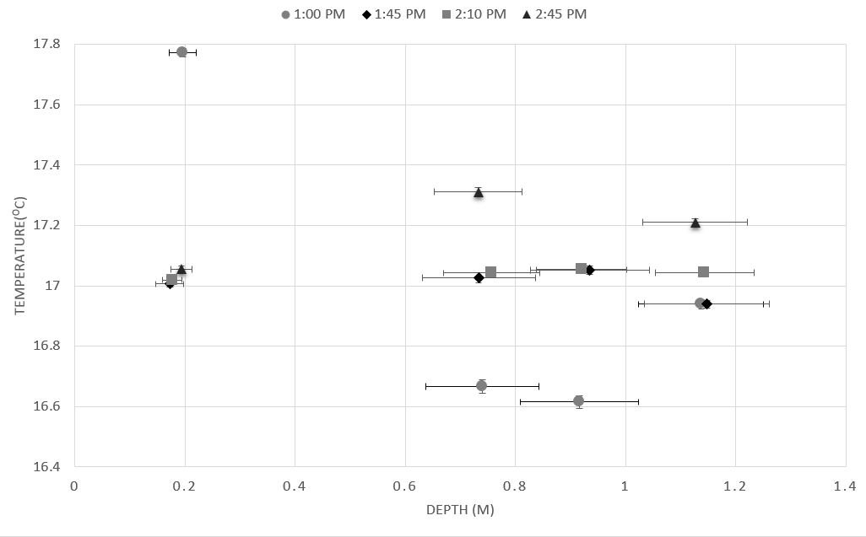
Notes:
Temperature changes across pressure are not very different as mentioned earlier, but also because uncertainty in depth is large (not a large enough range)
Saw a change of about 0.6 degrees Celsius in temperature over time of day, although this was only about 2 hours, and so would need more data across the data in order to see if this effect is mainly due to the water heating up throughout the day or some kind of tide effect

Slide 15
Suggestions for Further Study
Re-design turbidity amplification circuit
Implement full PID control
Locate and fix the source of noise when vertical motors turn on
Accurate pressure calibration at Dana Point
Larger data set - multiple days
Notes:
Implement D control
Redo Turbidity because by eye it appeared to get more turbid as the day progressed (i.e. tide came in). Also would help determine what is actually associated with tide
Discover where in PCBs the noise was coming from when vertical motors turned on
Be able to take more measurements as the tide was receding (i.e. earlier in the day)

Slide 16
Questions?

Slide 17
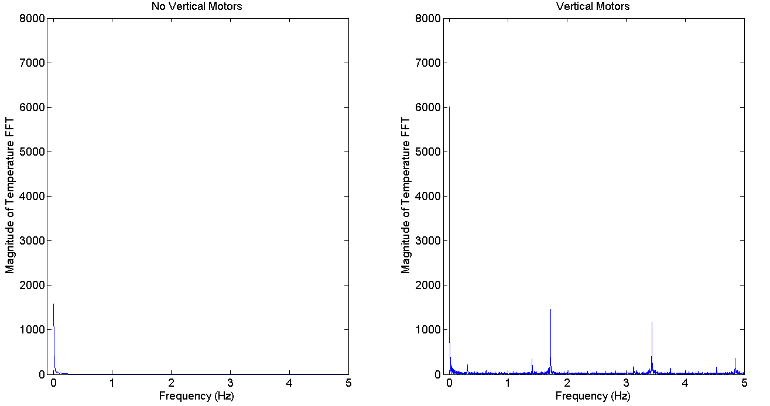
FFT

Slide 18
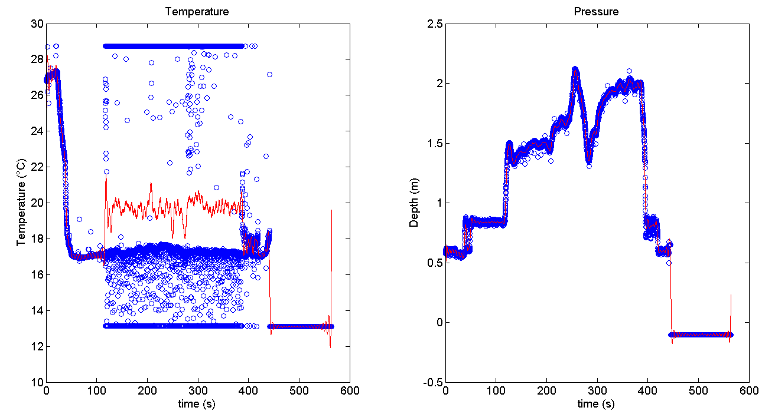
Fourier Transform Filtering

Slide 19
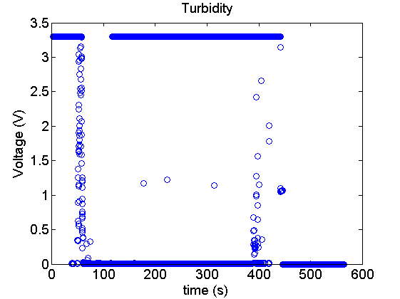
Turbidity Railing

Slide 20
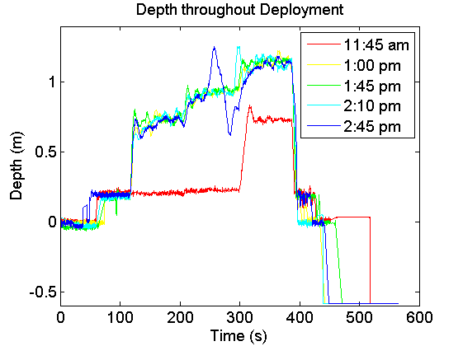

Slide 21
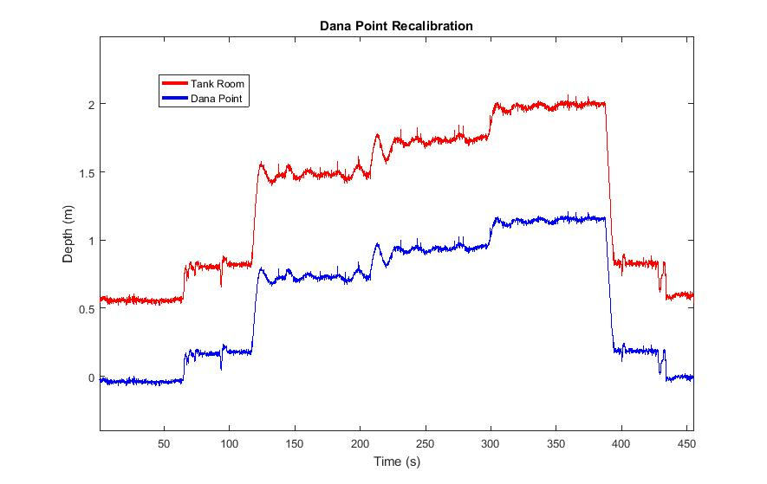

Slide 22
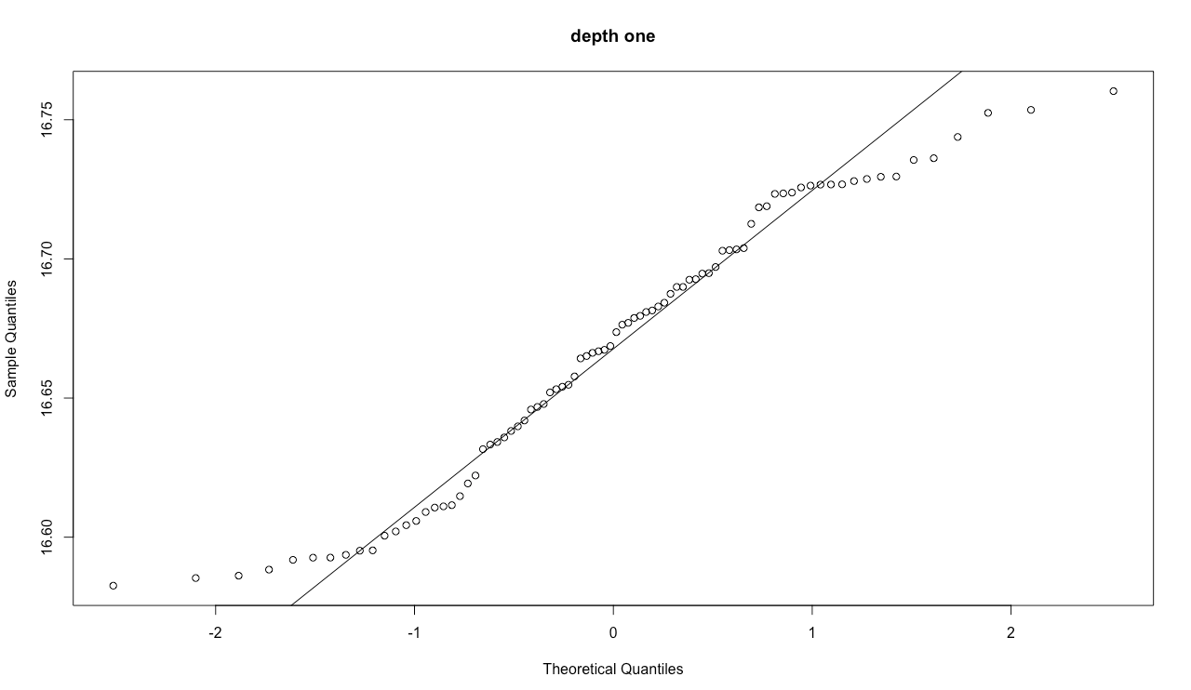
qq plot for normal distribution

